Slide 1
Bird Strike
Between 2000 - 2011

Slide 2
Introduction
Environmental and Safety Concerns: Increasing focus on the impact of transportation on the environment and safety.
Bird Strikes: Recognized as a major threat to aircraft safety.
MAS Technology: Essential for effectively addressing and mitigating these risks.

Slide 3
Objective
Bird strikes, which are collisions between birds and aircraft, are a serious safety issue. The Federal Aviation Administration (FAA) reported over 14,000 bird strikes in the U.S. in 2021. These strikes can cause major damage, especially to jet engines, potentially leading to engine failure and even crashes. Most incidents happen during critical flight phases like take-off, climb, approach, and landing, when planes are lower to the ground. The risk is higher near airports, particularly during bird migration seasons. To reduce these risks, effective wildlife management and technology, such as bird-monitoring radar, are crucial for enhancing aviation safety.

Slide 4
Problem Statement
The goal of this project is to analysis the bird strike incidents happened between 2000-2011. To achieve the goal, we used a data set that is collected by FAA during 2000-2011. The objective of the project is to perform data visualization techniques to understand insights of the data. This project aims apply various Business Intelligence tools such as Tableau or Power BI to get a visual understanding of the data.

Slide 5
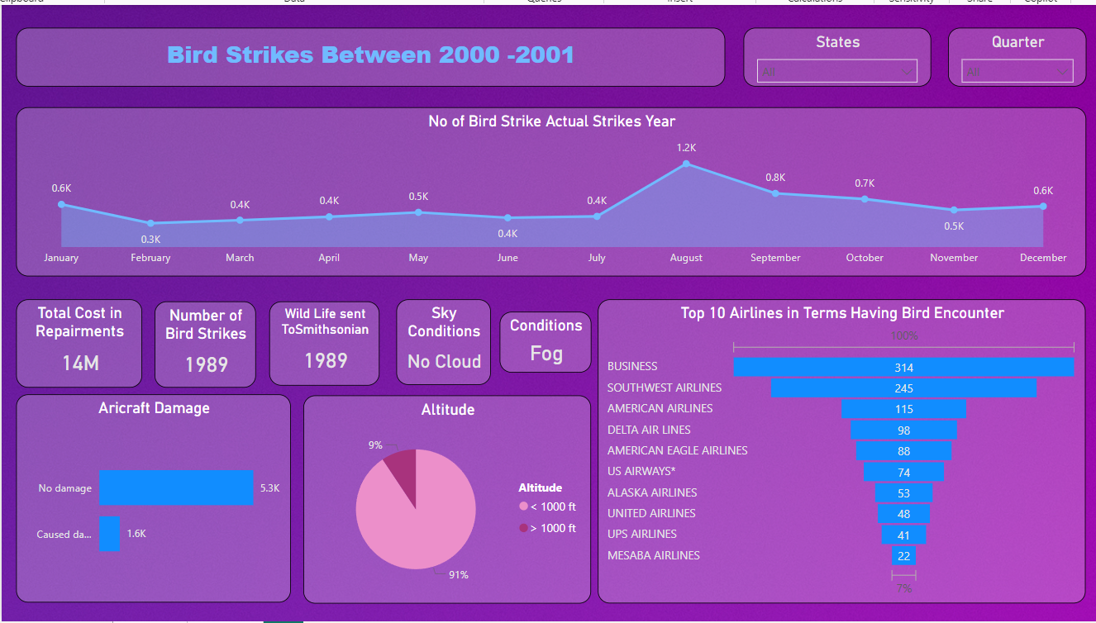
My Design

Slide 6
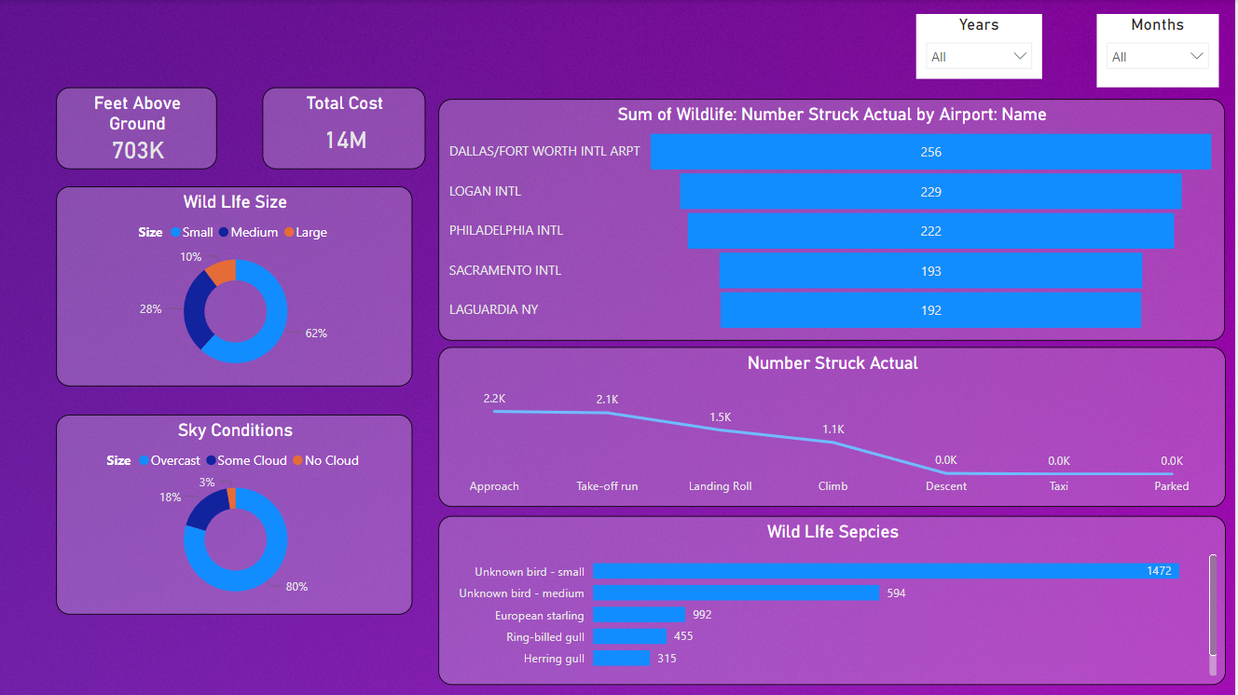
My Design

Slide 7
Conclusion
Pilot Warnings:- In 42.72% of cases, pilots received prior warnings about bird activity, which helps reduce aircraft damage.
Small Unknown Birds:- 52.78% of bird strikes involved small, unidentified birds.
Single Bird Strikes:- 72.9% of incidents resulted from striking one bird, which led to damage.
Damage Statistics:- 90.31% of bird strike incidents caused no damage, while 9.69% resulted in damage.
Altitude:- 80.84% of bird strikes occurred at altitudes below 1,000 feet, while 19.16% occurred above that level.

Slide 8
Thank You
Kunal Kedari
kunalkedari626@gmail.com

